Slide 1
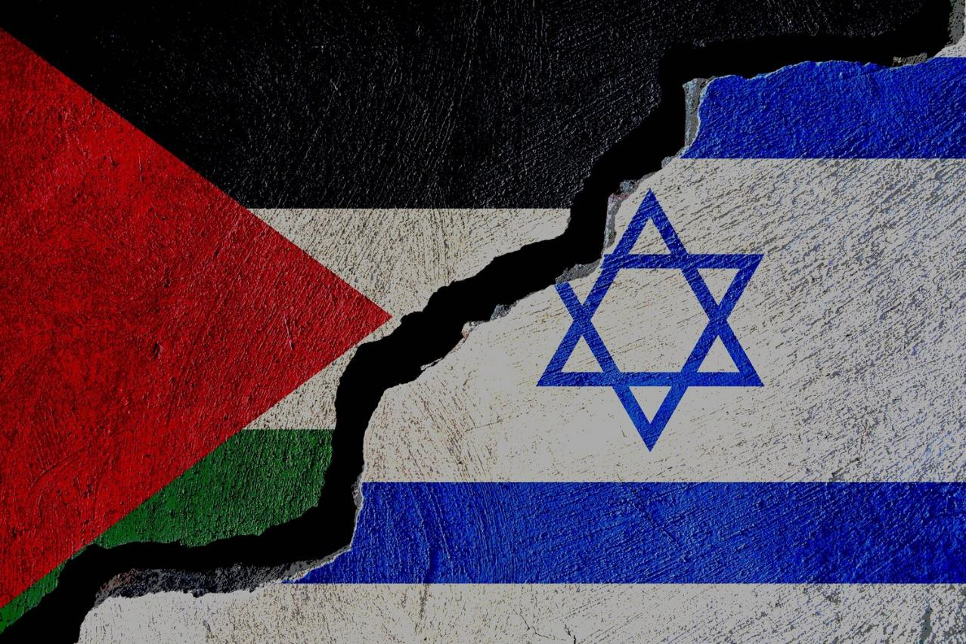
Israel/Palestine conflict?
Saad Ahmad(20P-0051)

Slide 2
What is the Israel/Palestine conflict?
The movement of Jewish people into the Muslim land.
Occupation of the West Bank and the Gaza Strip.
War over the Holy Land.

Slide 3
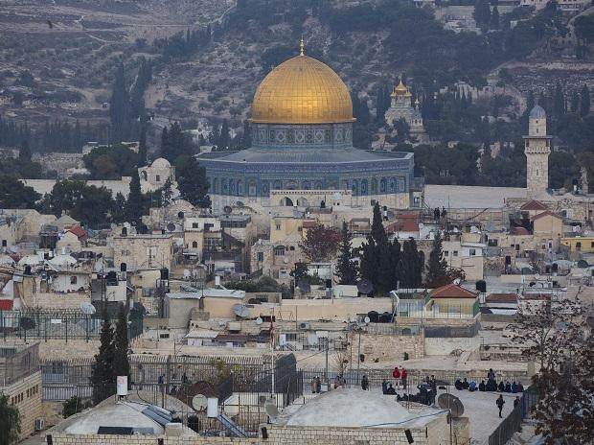
Holy Land
Jerusalem.
Destroyed.
Attacked.
Capture and recapture.

Slide 4

Thank you

